Slide 1
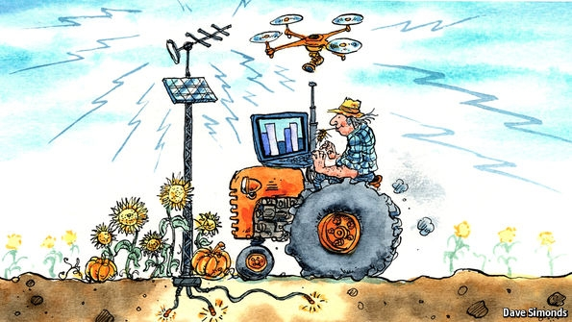
Green IOT Agriculture

Slide 2
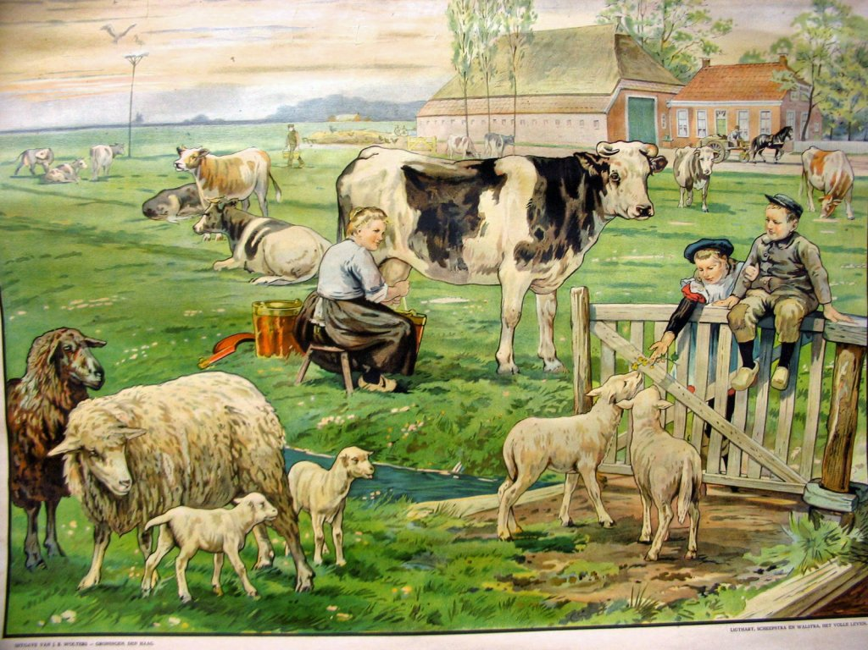
Classic Farming

Slide 3
The Future – What are we facing
The Food and Agricultural Organization of the UN (FAO) has predicted that the global population will reach 9.6 billion people by 2050.
In order to keep pace therefore with this growth, food production must increase by 70 percent by 2050.
In addition, a globally rising population needs to be fed in accordance with western lifestyles, set against growing shortages of land, water and energy. All these factors place huge pressures on the farming industry.

Slide 4
Challenges
The agriculture industry is faced with a number of challenges in achieving these imperatives, including:
The limited availability of arable land
Global climate change
The growing scarcity of water
The price and availability of energy, particularly from fossil fuels
The impact of urbanization on rural labor supply.

Slide 5
Challenges - Technology
Too much information
Energy
Connectivity

Slide 6
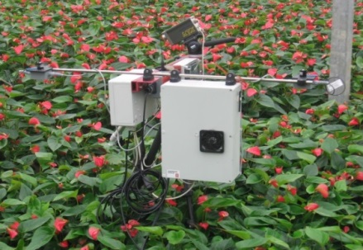
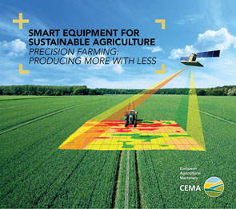
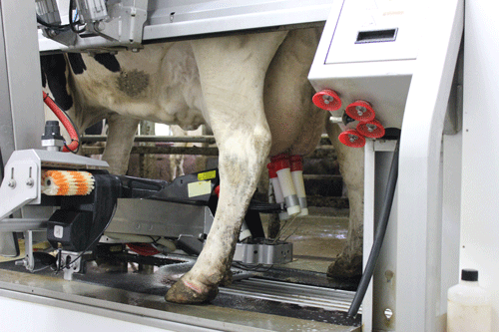

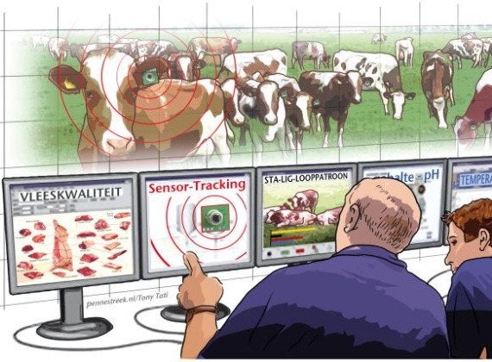
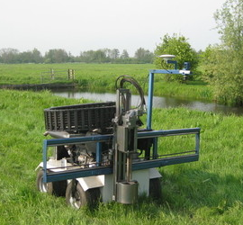
Future Farming
smart sensing & monitoring
BIG DATA
smart control
smart analysis & planning

Slide 7
IOT & Farming
Precision agriculture is sometimes known as 'smart farming', an umbrella term for easier comparison with other M2M based implementations such as smart metering, smart cities and so on.
Precision agriculture is based on sensor technologies

Slide 8
IOT & Farming
Experienced farmers have the knowledge to make the best judgements by just walking around their farms - Large farms in particular this is simply not practicable.
A remote 'eye in the field' or 'eye in the barn' makes remote monitoring possible in real time.
farmers can detect signs of disease in crops and animals much than they would otherwise become noticeable.
M2M-derived data feeds into a decision support system that allows farmers to see what is happening at a much higher level of granularity than previously possible. The approach of science to the field is a new trend

Slide 9


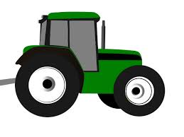
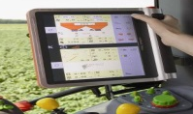
Redefining Industry Boundaries (according to Porter and Heppelmann, Harvard Business Review, 2014)
3. Smart, connected product
2. Smart Product
1. Product
+
+
+

Slide 10

Redefining Industry Boundaries (according to Porter and Heppelmann, Harvard Business Review, 2014)
5. System of systems
weather
maps
weather forecasts
weather data
application
4. Product system
rain, humidity,
temperature sensors
weather data system
farm
management
system
farm
performance
database
planters
farm equipment system
farm equipment system
seed optimizing system
combine
harvesters
seed
database
tillers
irrigation system
seed
optimization
application
field
sensors
irrigation
application
irrigation
nodes
Notes:
Current Farm management systems are not capable to do what is suggested in the picture. Therefore we have developed FIspace!

Slide 11
Connectivity
Wireless communications - from 2G to 4G - is the most preferable mode
The availability and reliability of cellular connectivity in rural environments can be very weak.
Data communications via satellite can be an option.
long-battery life devices working on low-data rate - even 2G connectivity can be expensive when available
The new range of LPWAN (Low Power Wide Area Network) is seen as a potential substitution of cellular connectivity in long battery life, long range connectivity scenarios and affordable rates (between 2 and 14 Euros per year).

Slide 12
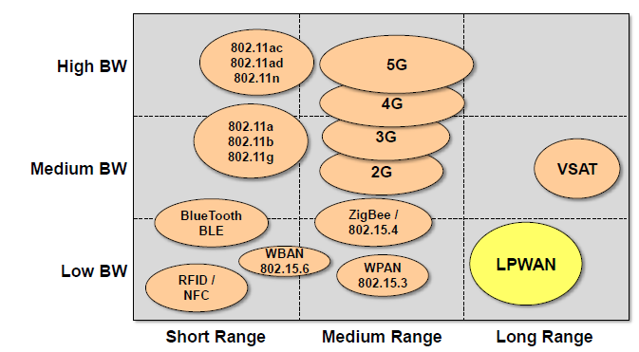
LPWAN

Slide 13
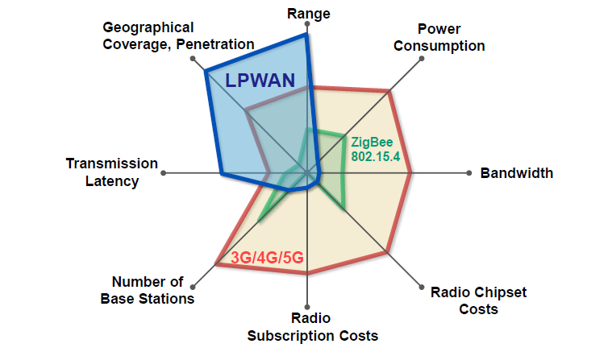
LPWAN

Slide 14
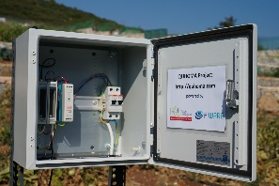
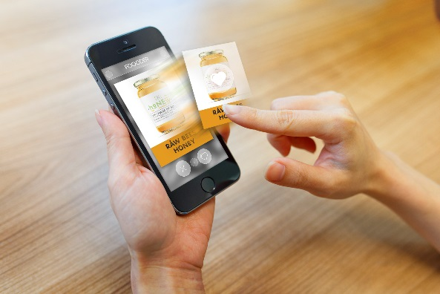


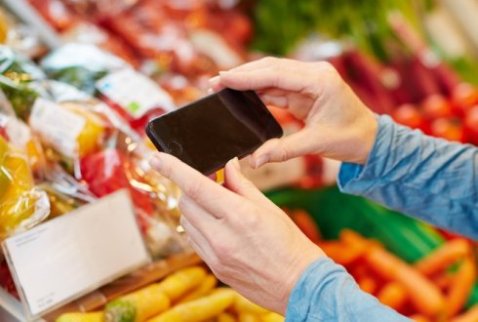
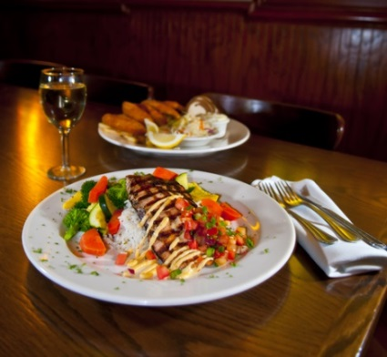
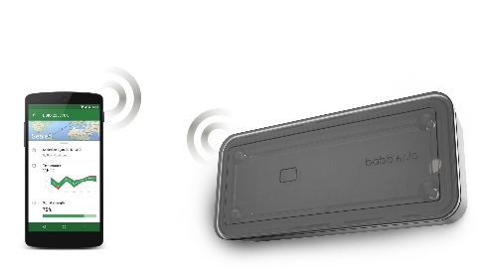
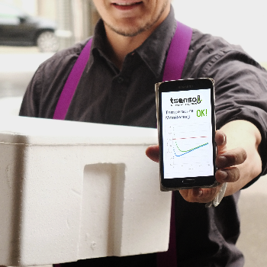
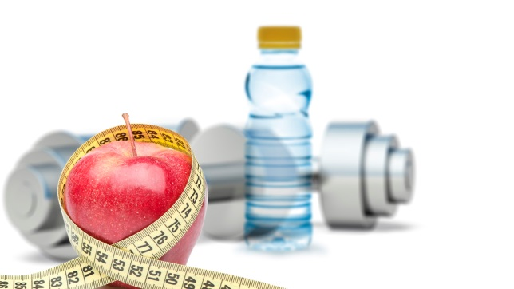
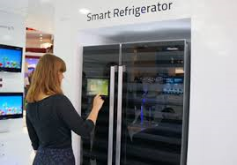
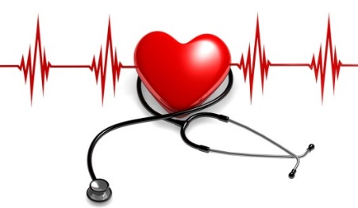
Involving the entire supply chain network and beyond
Smart Farming
tracking/& tracing
Smart Logistics
Fitness/Well-being
Domotics
Health
Source: Hisense.com
Notes:
SW: through smart production (farming) and logistics food ends at the consumers plate
Smart tracking and tracing is necessary to provide the right information about the product (contents, freshness, etc.)
This information can be related to other (IoT) domains such as:
Domotics (recipes, shopping, etc.)
Health (allergies, obesitas, etc.)
Fitness/Well-being (calorie-metering, healthy ingredients, etc.)
HS: There are already several examples from FIWARE phase 3, like tsenso, Babbler, Quhoma, Foooder

Slide 15
